Slide 1

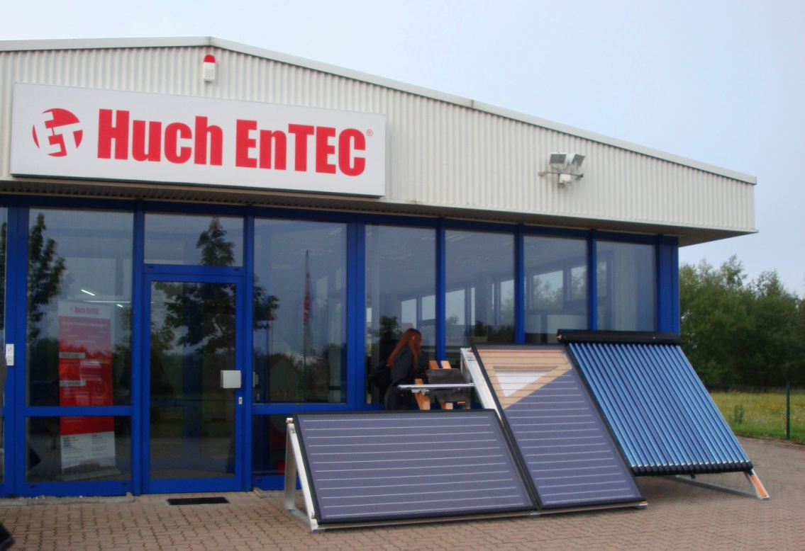
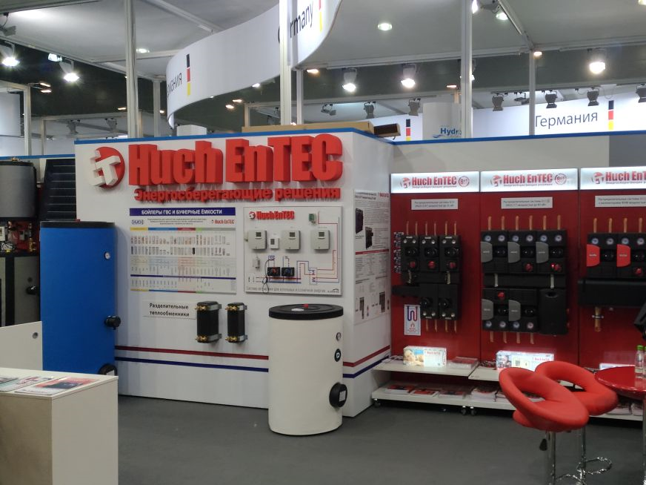
Boilers
Pumping groups
Solar systems
Controlling and servo drive

Slide 2
The group's turnover is 10,5 million EUR
Russia
Belarus
Ukraine
Kazakhstan

Slide 3
Huch EnTEC RUS Team - 2022
General Director
General coordination of the work, overall development of the company, marketing, branding
samoshenko@huchentec.ru
Sales
Product matrix, development of sales, pricing policy
sales@huchentec.ru
Engineer
Technical support of products, technical documentation, directory technical consultations, equipment selection, seminars
for installers and designers
products@huchentec.ru
Accounting
zhukova@huchentec.ru
Logistics & Office
Orders to suppliers, organization of delivery of products, work with the customs broker,
control coefficient logistics shipping, office manager
logistics@huchentec.ru
Сustomer Service
Work with customers, invoicing, organization of delivery of products to customers, turnover of stock and illiquid assets
manager@huchentec.ru
Warehouse
sklad@huchentec.ru

Slide 4
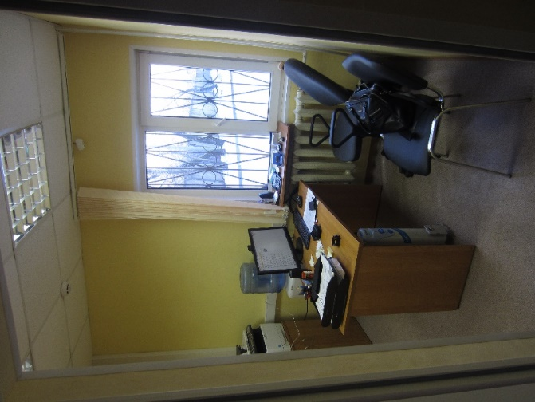
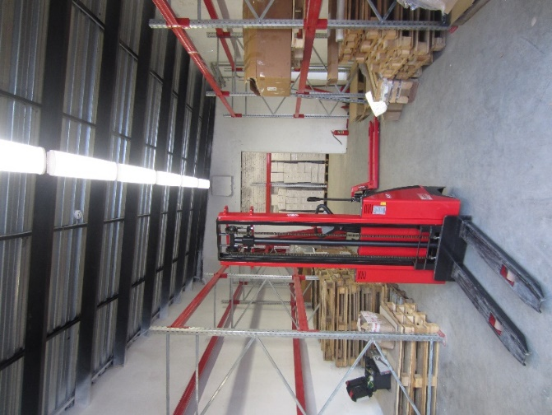
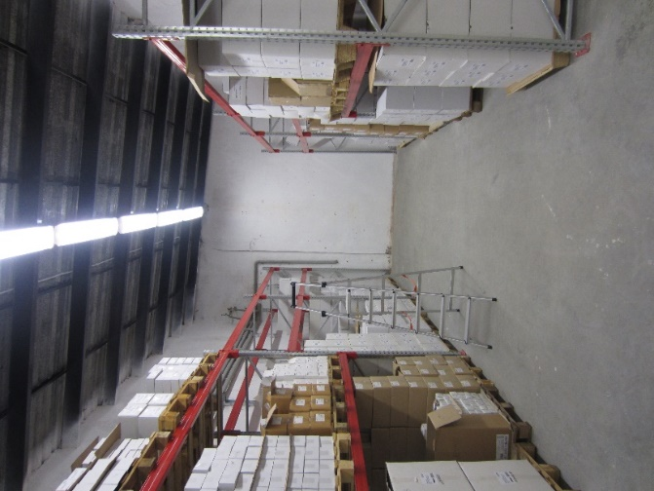
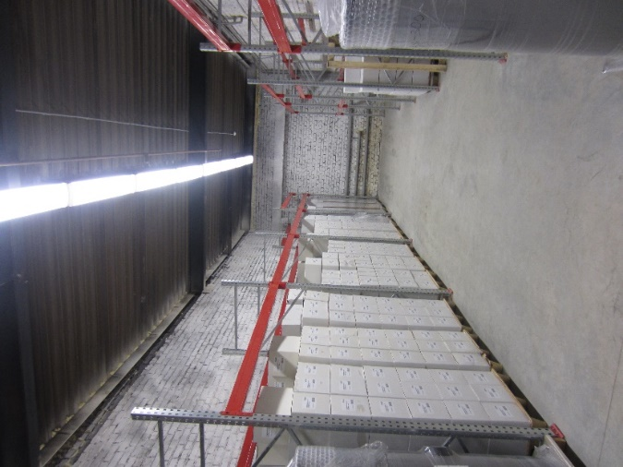
Warehouse
Office and warehouse Moscow in one place.
More than 1000 m2

Slide 5
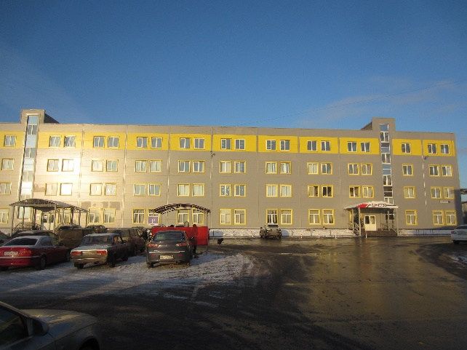
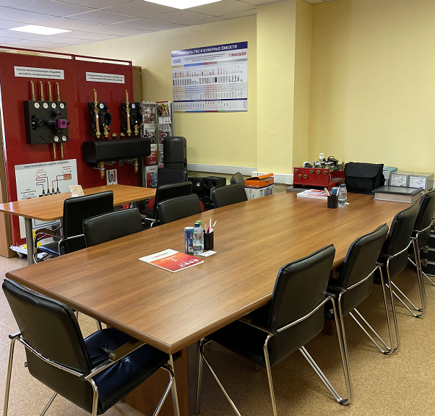
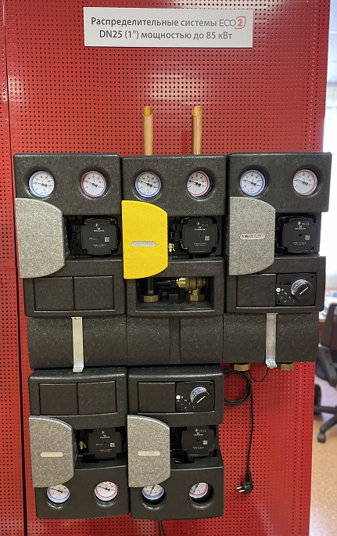
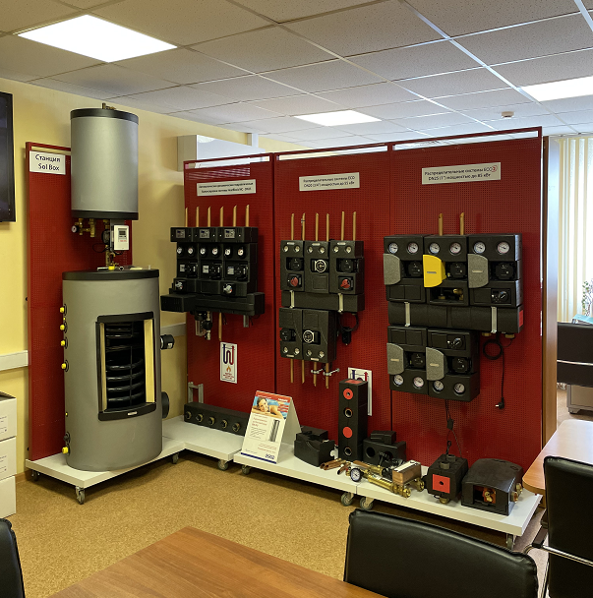
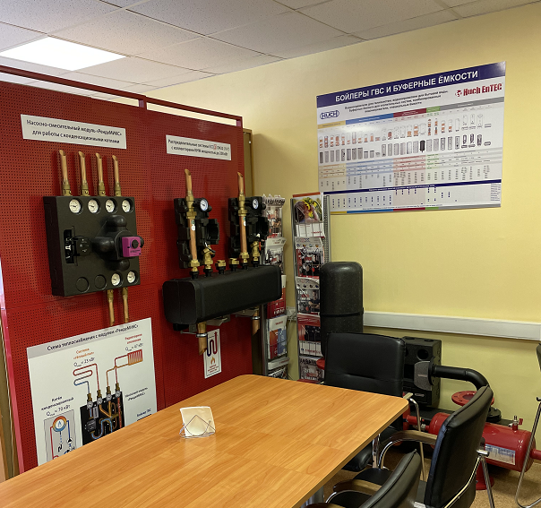
Office Moscow

Slide 6
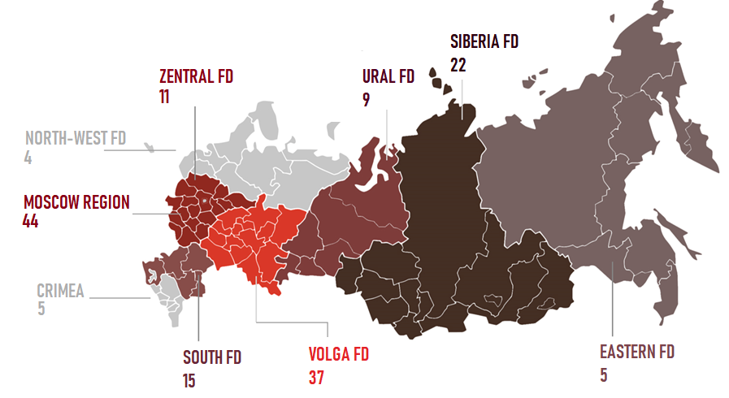

Partners
More than 100 dealers

Slide 7
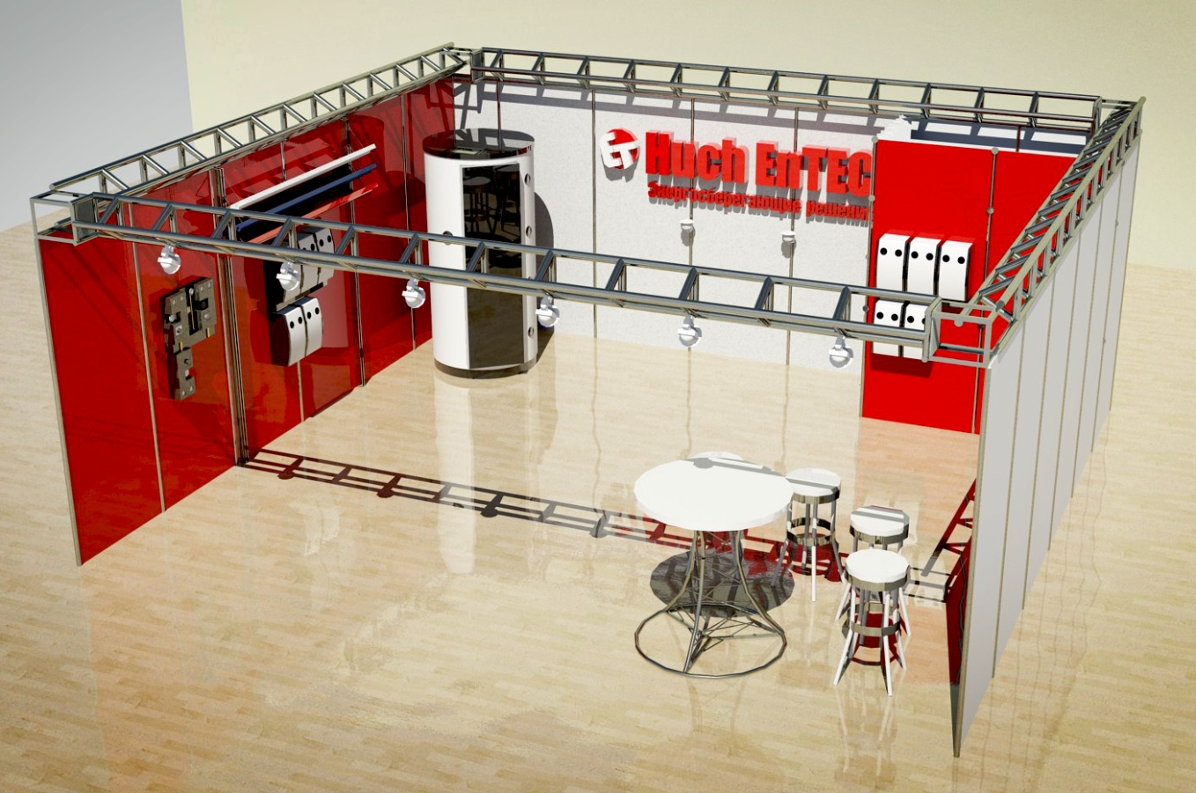
Marketing, Advertising
Specialized magazines:
COK - 3 releases
Aqua-Therm – 2 releases
Site Huch EnTEC RUS
Catalog Huch EnTEC RUS
translated, designed, printed
Leaflet Huch EnTEC RUS
(more then 15))
compiled, printed
Aqua- Therm -2020 (Moscow) exhibition
paid, prepared;
our place: hall 14, stand B524

Slide 8
Development
Team:
Office Moscow-Leipzig-Kiev-Minsk-Almaty-Tashkent/ representatives in Rostov-on-don, St. Petersburg, Samara, Perm, Krasnoyarsk
Sale:
to implement the plan 12 billion Euro ; further development the partner matrix - intensifying the work of the existing partners and new ones; development of project sales, more then 100 Partner in all region of Russia
Work trips
on factory and to Russia
Marketing:
COK and Aqua-Therm magazines – January’s releases to Aqua-Therm (Moscow and Novosibirsk);
Aqua-Therm exhibition, (Moscow) once every two years;
Survey seminars in all the key cities, seminars for designers; Media, a general website Huch EnTEC RUS

Slide 9
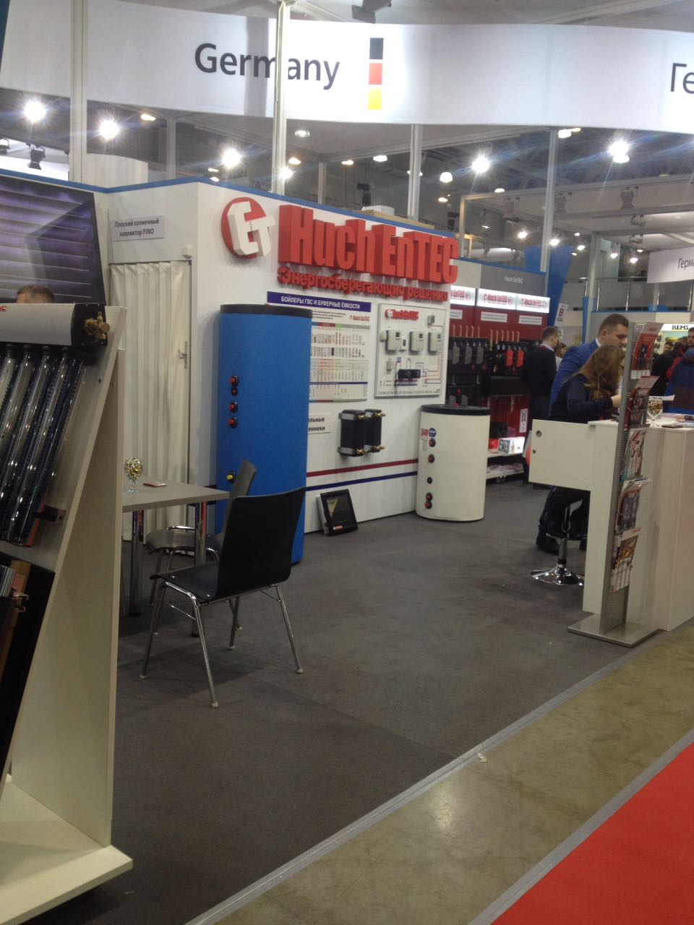

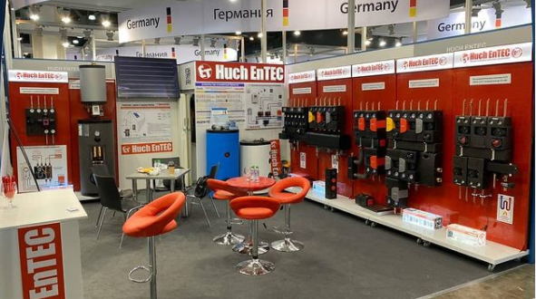
Exhibition Aqua-Therm-2020 (Moscow)

Slide 10
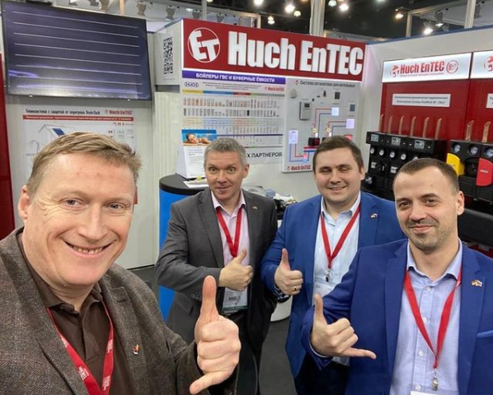
Thank you for your attention!
Look forward to working with you!

Slide 11

CONTACTS
CONTACTS
117623 Моscow
2. Мelitopolskaya str., Bld 4А, Str 40
Tel.: +7 495 249 04 59
E-mail: info@huchentec.ru
www.huchentec.ru

